Slide 1
Course: MOBI8001 - Mobile Technology and Cloud Computing
Period: March 2017
Privacy and Security in Mobile Cloud Computing
Session 12
D5627 – I Gede Putra Kusuma Negara, B.Eng., PhD

Slide 2
Outline
Introduction
Security Needed in Different Levels for Securing Mobile Cloud Computing
Security Issues in Mobile Cloud Environment
Conclusion
Bina Nusantara University

Slide 3
Introduction
There has been a drastic increase in the use of smartphones in recent years.
According to ABI Research predictions, the number of mobile cloud users will grow from 42.8 million (1.1% of total mobile users) in 2008 to 998 million (19% of total mobile users) in 2014.
The security of smartphones is becoming increasingly important because they offer advanced services such as web browsing, instant massing, e-commerce, as well as personal and economical information storage.
The proliferation of mobile malware increased by 46% in 2010 compared to 2009.
74% of chief information officers and IT executives are not willing to adopt cloud services because of the risks associated with security and privacy.
Bina Nusantara University

Slide 4
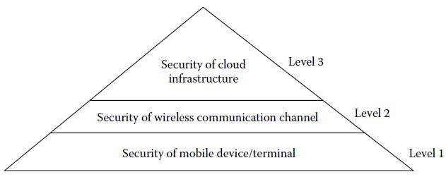
Security Needed in Different Levels
The security and privacy risk should be deeply analyzed in three aspects:
  Security of mobile device/terminal
  Security of wireless communication channel
  Security of cloud infrastructure
Bina Nusantara University

Slide 5
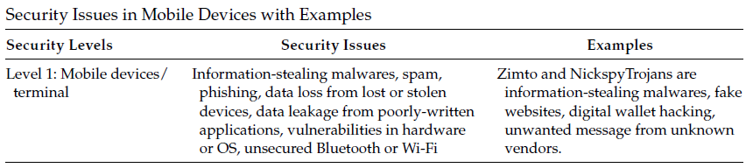
Security Needed in Different Levels
Level 1: Security Issues in Mobile Devices
Approaches to Mitigate Security Issues:
  Antimalware programs are run on the devices to identify and delete Trojan horse, viruses, and worms.
  Periodically updating the OS and downloading applications from known vendors.
  If a device is stolen or lost, there must be some remote data wiping technique so that the data cannot be misused.
  The mobile device can also use hardware based encryption techniques for internal and external memory support.
Bina Nusantara University

Slide 6
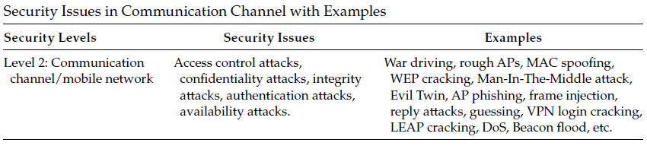
Security Needed in Different Levels
Level 2: Security Issues in Communication Channels
Approaches to Mitigate Security Issues:
  Encrypt data while transmitting into cloud.
  Use secure transmission protocols such as https and SSL.
  Socket programming is also used for secure transmission of sensitive data in a cloud environment.
  Strong password and biometric authentication should be used to enhance data security during transmission.
  Switching off the wireless interfaces, such as Wi-Fi and Bluetooth, after using the mobile device will also help.
Bina Nusantara University

Slide 7
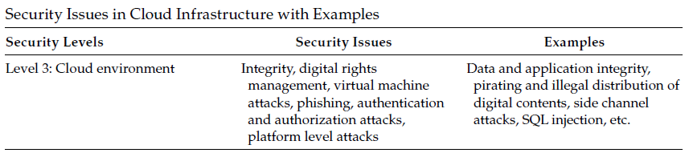
Security Needed in Different Levels
Level 3: Security Issues in Cloud Computing
Approaches to Mitigate Security Issues:
  The location of stored data should be free from geopolitical issues; thus, the privacy and security of data should be maintained.
  There must be a mechanism to recover the user’s data if the data is lost or erased by an attacker.
  There should also be a secure and efficient key management mechanism for the cloud environment.
  Cloud should use an implicit authentication technique to reduce the risk of fraud in a mobile cloud.
Bina Nusantara University

Slide 8
Security Issues in Mobile Cloud Environment
Application Security
Authentication Issues
Data Security
Digital Rights Management
Intrusion Detection
Bina Nusantara University

Slide 9
Security Issues in Mobile Cloud Environment
Application Security
  A number of applications are run on mobile devices.
  Good applications are modified using malicious codes and are spread through unofficial repositories.
  Such applications leak private data, dial premium numbers, and are backdoor triggered via SMS, for example.
Bina Nusantara University

Slide 10
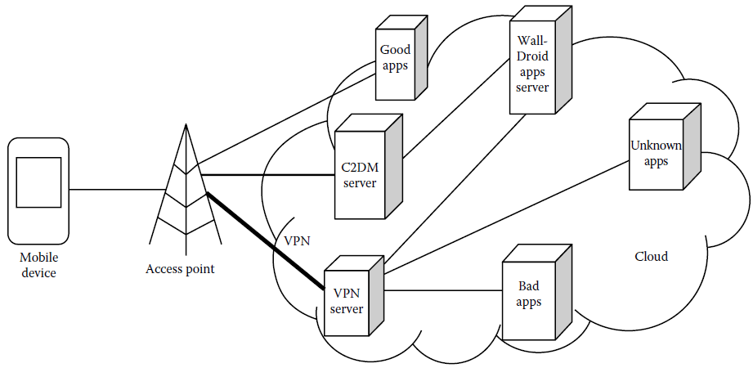
Security Issues in Mobile Cloud Environment
Application Security - Existing Schemes
  WallDroid: Application Specific Firewalls for the Android OS
Bina Nusantara University

Slide 11
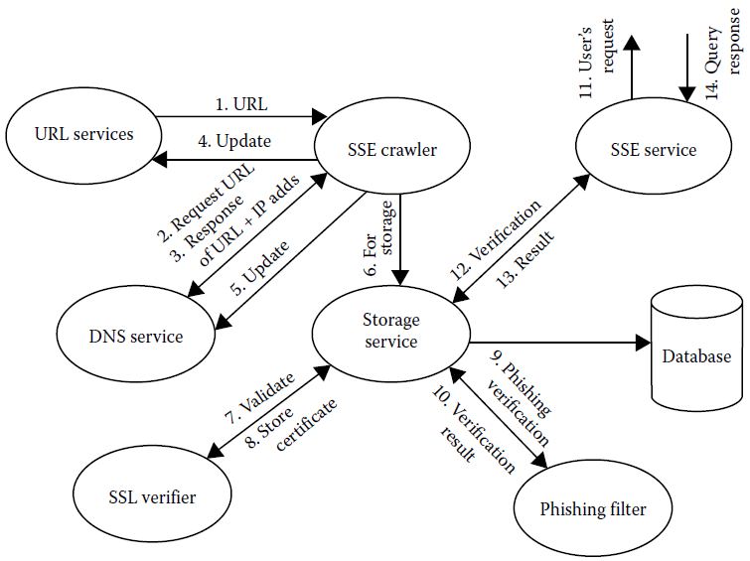
Security Issues in Mobile Cloud Environment
Application Security - Existing Schemes
  Secure Search Engine (SSE): protection against phishing websites and SSL strip-based MITM attack.
Bina Nusantara University

Slide 12
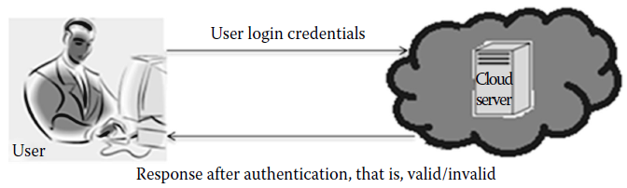
Security Issues in Mobile Cloud Environment
Authentication Issues
The migration of private and enterprise data to the cloud raises security and privacy issues.
To access these sensitive data only by the legitimate users, an authentication protocol is used.
Traditionally, a user provides his or her password to the requested server for authentication, which may be attacked.
Bina Nusantara University

Slide 13
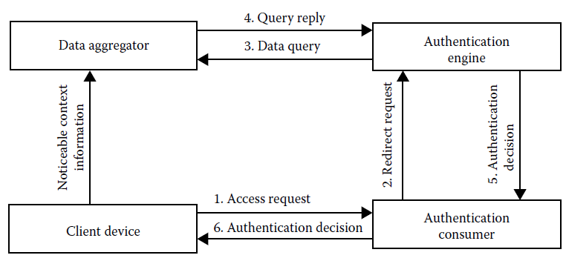
Security Issues in Mobile Cloud Environment
Authentication Issues - Existing Schemes
  TrustCube: cloud authentication platform
  Implicit authentication: probabilistic authentication score according to user’s behavior.
Bina Nusantara University

Slide 14
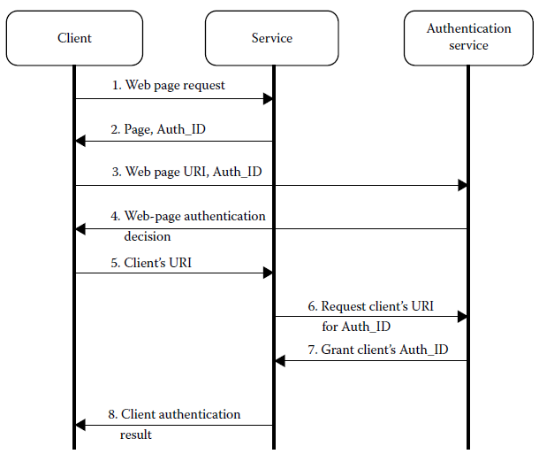
Security Issues in Mobile Cloud Environment
Authentication Issues - Existing Schemes
  SeDiCi 2.0: a zero knowledge proof (ZKP) technique for authentication ID
Bina Nusantara University

Slide 15
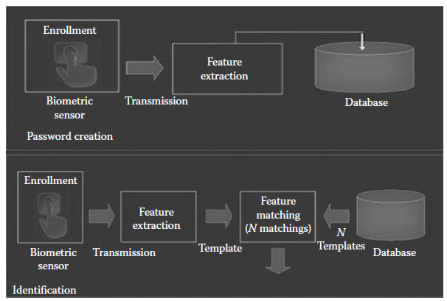
Security Issues in Mobile Cloud Environment
Authentication Issues - Existing Schemes
  Biometric encryption: advance protocol for authentication using biometric sensors
Bina Nusantara University

Slide 16
Security Issues in Mobile Cloud Environment
Data Security
  Important data are offloaded to the cloud, such as private, commercial, financial, and enterprise data
  Leakage of such sensitive data to others may lead to personal and economic loss.
  There must be some mechanism to know data integrity and data to be available when needed.
Bina Nusantara University

Slide 17
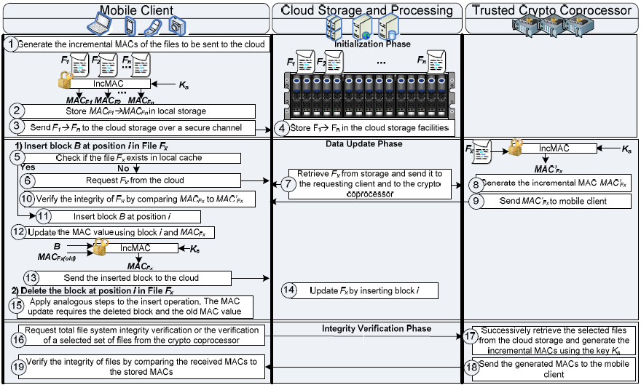
Security Issues in Mobile Cloud Environment
Data Security - Existing Schemes
  Incremental cryptography (MAC):
Bina Nusantara University

Slide 18
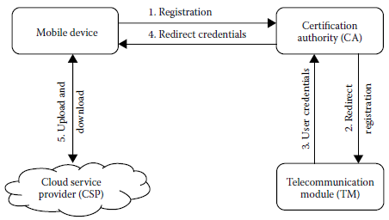
Security Issues in Mobile Cloud Environment
Data Security - Existing Schemes
  Standard hash function, digital signature:
Bina Nusantara University

Slide 19
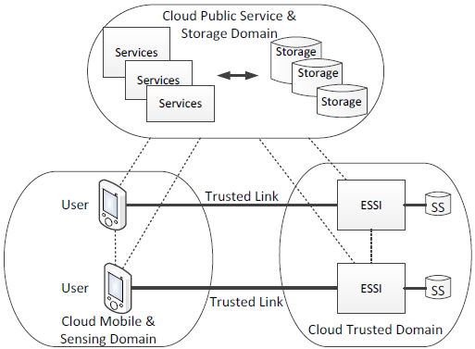
Security Issues in Mobile Cloud Environment
Data Security - Existing Schemes
  Attribute-based encryption and identity based cryptography: ensures security and privacy for mobile devices with the help of multi-tenant secure data management and trust management, and extended semi-shadow image (ESSI)-based data processing model.
Bina Nusantara University

Slide 20
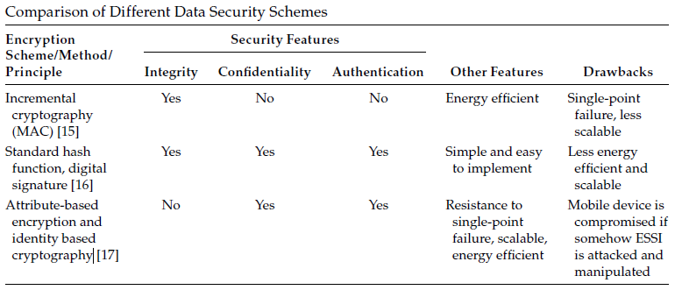
Security Issues in Mobile Cloud Environment
Data Security - Existing Schemes
Bina Nusantara University

Slide 21
Security Issues in Mobile Cloud Environment
Digital Rights Management (DRM)
  Digital contents such as e-books, images, audios, videos, and so on, are now stored in cloud.
  Mobile users can access these contents using the Internet from the cloud servers.
  These digital contents could be pirated and distributed illegally.
  Digital rights management checks this abuse by regulating content usage.
  The DRM system allows only authorized users who have the license to access such contents.
Bina Nusantara University

Slide 22
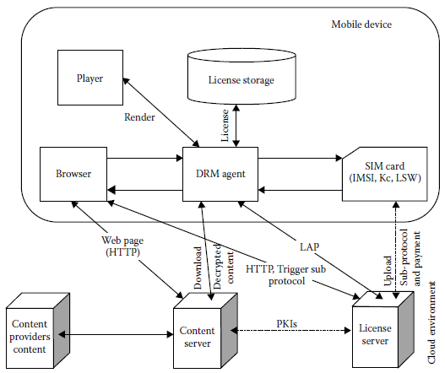
Security Issues in Mobile Cloud Environment
DRM - Existing Schemes
  CS-DRM: a cloud-based SIM DRM
Bina Nusantara University

Slide 23
Security Issues in Mobile Cloud Environment
Intrusion Detection
  Smartphones use the same software architecture as PCs, and they are attacked by same class of viruses, worms, malware, and Trojan horses.
  These malware programs get into the smartphones through unofficial repositories and carry out their malicious activities.
  Since the antivirus software is based on loading signatures that require storage, and as they run on mobile instruments, they draw a large amount of CPU and battery power.
  Smartphones have limited resources, so such solutions are not efficient for these devices.
  Hence, some lightweight intrusion detection schemes are proposed by researchers, which are based on the integration of the mobile device and cloud computing.
Bina Nusantara University

Slide 24
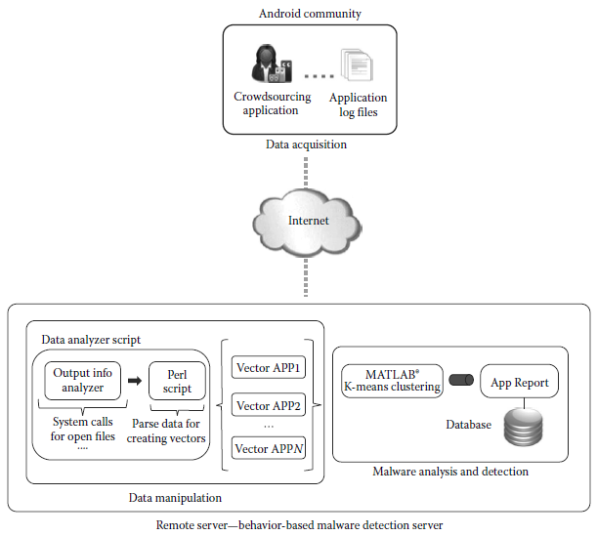
Security Issues in Mobile Cloud Environment
Intrusion Detection - Existing Schemes
  Crowdroid: Behavior-based malware detection for Android phones
Bina Nusantara University

Slide 25
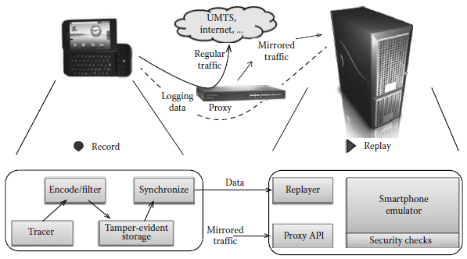
Security Issues in Mobile Cloud Environment
Intrusion Detection - Existing Schemes
  Paranoid Android (PA): a versatile security, which offers a wide range of security measures for smartphones
Bina Nusantara University

Slide 26
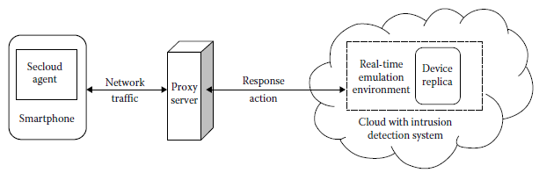
Security Issues in Mobile Cloud Environment
Intrusion Detection - Existing Schemes
  Secloud: a powerful intrusion detection scheme that uses the cloud to protect smartphones.
Bina Nusantara University

Slide 27
Conclusion
Mobile cloud computing raises a number of security threats both in the cloud and in the devices.
These threats are mostly a combination of mobile device threats, communication threats, and cloud environment threats.
To provide security in the MCC environment, the cloud provider should ensure data security, network security, data locality, data integrity, application security, data segregation, data access, data breach issues, and various other factors.
Bina Nusantara University

Slide 28
References
Debashis De. (2015). Mobile Cloud Computing: Architectures, Algorithms and Applications. 01. Chapman and Hall/CRC Press. Florida. ISBN: 9781482242836. Taylor & Francis Publishing ISBN- 978–0–203–88776–9
F. S. Gharehchopogh, R. Rezaei, and I. Maleki, Mobile cloud computing: Security challenges for threats reduction, International Journal of Scientific and Engineering Research, 4(3), 8–14, 2013.
S. K. V. Ko, J. H. Lee, and S. W. Kim, Mobile cloud computing security considerations, Journal of Security Engineering, 9(2), 143–150, 2012.
S. Hui, Z. Liu, J. Wan, and K. Zhou, Security and privacy in mobile cloud computing, in Ninth International Wireless Communications and Mobile Computing Conference, Sardinia, Italy, pp. 655–659, 2013.
M. S. Morshed, M. M. Islam, M. K. Huq, M. S. Hossain, and M. A. Basher, Integration of wireless hand-held devices with the cloud architecture: Security and privacy issues, in International Conference on Parallel, Grid, Cloud and Internet Computing, Barcelona, Spain, pp. 83–88, 2011.
Bina Nusantara University

